Slide 1


SMART INDIA HACKATHON 2026
Problem Statement CHA-39
Cybersecurity Portal for Effective Management of Servers and Firewalls
Theme: Blockchain & Cybersecurity
Category: Software
Team Name: Cyber Lakshya
Team ID: DEPSTAR-SIH-880700
@SIH Idea submission
1

Slide 2
Cyber Lakshya
SECUREDGE
Proposed Solution: Centralized Server & Firewall Management
dns
01. Centralized DCIM
security
02. Zero-Trust Mitigation
psychology
03. Smart Innovation
An enterprise-grade Data Center Infrastructure Management (DCIM) portal built using a high-throughput Go backend and robust PostgreSQL storage.
Real-time monitoring: Health checks across thousands of distributed servers.
Automated firewall: Rapid policy enforcement and rule distribution.
Unified console: Centralized command center dashboard.
Directly addresses identity verification deficits and administrative latency by enforcing strict Zero Trust Architecture.
RBAC controls: Enforced with secure high-entropy JWT keys.
State pipelines: Prevents single-point credential compromises.
Default-Deny: Secures and closes vulnerable open-ports.
Moves security and operations from manual, reactive firefighting to proactive, autonomic intelligence.
Kernel eBPF: Sandboxed monitoring to block malicious processes instantly.
Isolation Forests: ML for explainable threat logging anomalies.
Digital Twins: Thermal CFD simulation to prevent hardware failures.

Slide 3
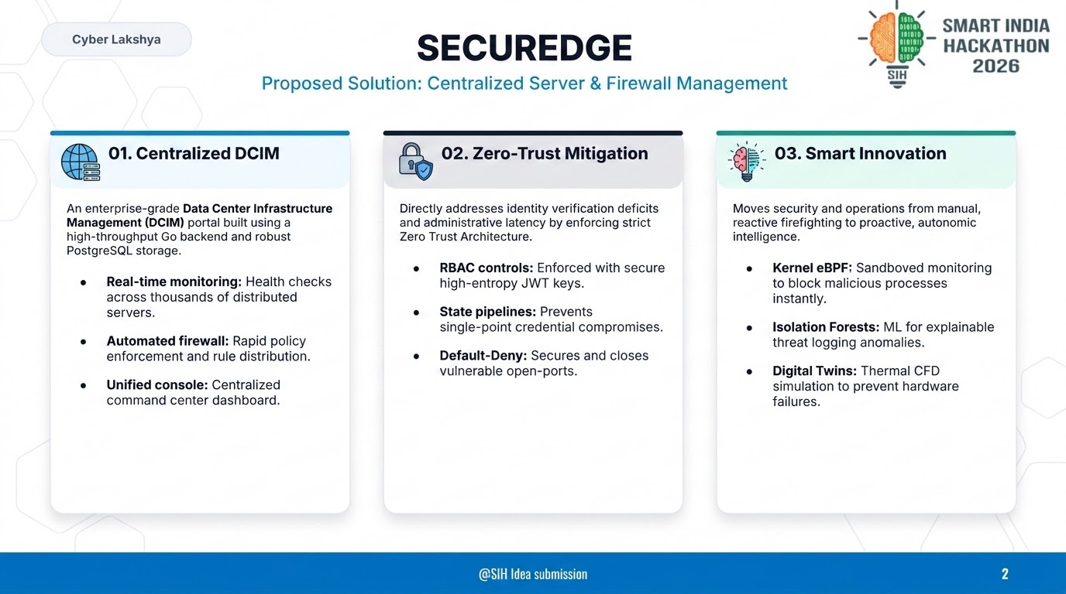

Slide 4

Cyber Lakshya
TECHNICAL APPROACH
SecurEdge Architecture & Methodology
layers
01. Core Tech Stack
hub
02. Architecture
speed
03. Process & Build
Production-ready technologies selected for enterprise performance, scalability, and security.
Go Backend: High-throughput Go APIs for efficient, lightweight processing.
Databases: PostgreSQL for persistent storage with Redis caching.
Containers: Docker-based microservices for reliable orchestration.
Multi-layered system architecture designed to isolate core environments and secure traffic routes.
Shell Model: Strict boundaries between internal and external networks.
Go API Gateway: Centralized endpoint routing and RBAC enforcement.
Flow Mapping: Detailed visualization of server-to-firewall data streams.
A methodical, phase-by-phase implementation plan ensuring a stable and verified prototype launch.
4-Week Sprint: Fast-paced development targeting the core Monolith.
Working Prototype: Continuous validation of anomaly alert pathways.
SIH 2026 Target: Fully prepared for live, secure evaluation.

Slide 5
Cyber Lakshya
FEASIBILITY AND VIABILITY
Evaluating Practical Implementation & Risk Mitigation
assessment
01. Feasibility Analysis
warning
02. Challenges & Risks
verified_user
03. Overcoming Risks
A comprehensive evaluation of technical, operational, and financial feasibility of the proposed solution.
Technical Viability: Assessing stack compatibility and performance metrics.
Operational Fit: Seamless integration with standard data center layouts.
Resource Demands: Lean developer overhead with efficient microservices.
Identification of potential bottlenecks, legacy security threats, and adoption barriers during rollout.
Integration Latency: Sync delays during legacy firewall rules mapping.
Security Vectors: Managing identity verification across mixed networks.
Adoption Hurdles: Overcoming the initial learning curve for operators.
Proactive strategies and architectural design choices to completely neutralize identified risks.
Phased Rollout: Deploying in sandboxed environments first to test load.
RBAC Enforcement: Hardening access using high-entropy JWT keys.
Automated Fallbacks: Instant configuration recovery during failures.

Slide 6
IMPACT AND BENEFITS
Transformational Value & Strategic Advantages
Cyber Lakshya
groups
01. Target Impact
Direct and meaningful advantages delivered to the end-users and key stakeholders.
User Empowerment: Enhancing daily operations and accessibility for the core audience.
Efficiency Gains: Streamlining legacy workflows to save time and reduce manual friction.
eco
02. Social & Eco
Fostering positive community transformation and supporting ecological sustainability.
Inclusive Design: Creating equitable access for diverse and underserved populations.
Eco Footprint: Minimizing carbon output and optimizing digital resource usage.
trending_up
03. Economic & Scale
Delivering measurable financial returns, cost savings, and scalable growth pathways.
Cost Optimization: Reducing operational expenditures through modern architecture.
Future Scalability: Ensuring the platform scales seamlessly with growing demand.

Slide 7
Cyber Lakshya
RESEARCH & REFERENCES
Standards, Regulatory Frameworks, and Academic Literature
gavel
01. Regulatory Standards
psychology
02. Academic & Systems AI
dns
03. Engineering Best Practices
Alignment with global security frameworks and cybersecurity guidelines established by state authorities.
NIST SP 800-53: Adhering to federal security controls and continuous ZTA baseline monitoring guidelines [cite: 33, 48].
MeitY Guidelines: National regulations for high-integrity server log management and data protection [cite: 12, 33].
Scientific literature supporting our sandboxed monitoring and AI-driven predictive telemetry.
eBPF Monitoring: Safe kernel-level event tracing for threat containment without performance loss [cite: 6].
Isolation Forest: Multi-dimensional anomaly detection algorithms used for network log stream analysis [cite: 6, 8].
Technical design benchmarks guaranteeing resilient database architecture and access governance.
RFC 7519 (JWT): Industry standard implementation for stateless authentication and RBAC claims.
PostgreSQL & Redis: High-concurrency benchmarks for transactional persistence and optimized performance caching.

